Slide 1
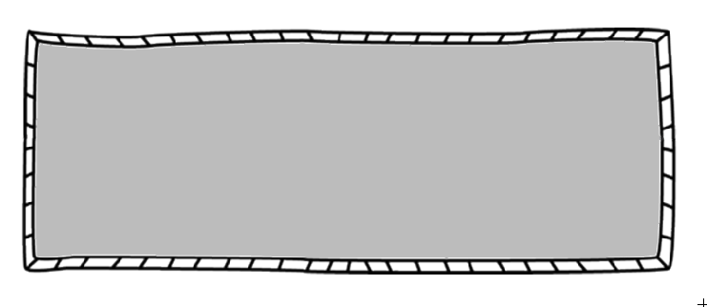
How do I know what’s going on in my child’s class?
Agendas are sent out EVERY week through email. These emails include the topics being discussed, as well as homework and assignments due.
Class Dojo
Our classroom website at :
http://mrsburchscience.weebly.com/
We will be using the McGraw-Hill Physical Science textbook. Digital copies of the textbook can be placed on your child’s flash drive.
Supply
List
2 composition notebooks
2 pocket folder with brads
flashdrive
earbuds
ClassDojo is the easiest way for teachers to encourage students, and share their best moments with parents.
Any classroom, any device. 100% free.
Donnie Bickham
Middle School
Physical Science
Mrs. Burch
tmburch@caddoschools.org
(318)929-4106
Homework Policy
Extra Help
Homework will be posted on the class
Edmodo site and sent via Remind101 daily.
•Homework will be given frequently.
•Late homework will not be accepted.
•Perfect homework = 2pt grade bonus.
If a student is having trouble they should speak with the teacher as soon as possible. The teacher will work with the student to schedule time for extra help. Extra help is available before and after school but parent-teacher contact is necessary to ensure that transportation is available.

Slide 2
Physical Science
Course Guide
2015-2016
I have read and understand the course guide.
_________________________________
Student Name
_________________________________
Student Signature
_____________
Date
_________________________________
Parent/Guardian Name
_________________________________
Parent/Guardian Signature
_____________
Date

